Slide 1
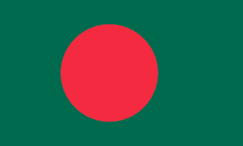
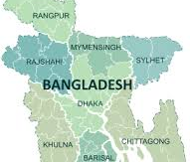
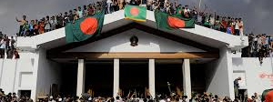
BANGLADESH

Slide 2
About Bangladesh
Bangladesh,^{[a]} officially the People's Republic of Bangladesh,^{[b]} is a country in South Asia. It is the eighth-most populous country in the world and among the most densely populated with a population exceeding 170 million within an area of 148,460 square kilometres (57,320 sq mi). Bangladesh shares land borders with India to the north, west, and east, and Myanmar to the southeast. To the south, it has a coastline along the Bay of Bengal. To the north, it is separated from Bhutan and Nepal by the Siliguri Corridor, and from China by the mountainous Indian state of Sikkim. Dhaka, the capital and largest city, is the nation's political, financial, and cultural centre. Chittagong is the second-largest city and the busiest port of the country. The official language is Bengali. Islam is the official and largest religion and Bengali Muslims form the largest ethnoreligious group in the country.

Slide 3
Division of Bangladesh :
The administrative structure of Bangladesh currently comprises eight divisions (Bengali: bibhag) at first- order administrative level (ADM1)8:
Barishal
Chattogram
Dhaka
Khulna
Rajshahi
Rangpur
Mymensingh and
Sylhet.

Slide 4

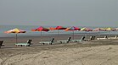
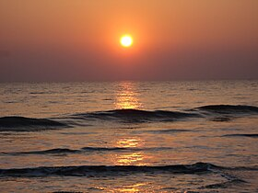

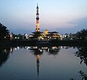
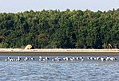
BARISHAL
Barisal Division is one of the eight administrative divisions of Bangladesh. Located in the south-central part of the country, it has an area of 13,225 km² (5,106 sq mi), and a population of 9,325,820 at the 2022 Census. It is the least populous Division in Bangladesh. It is bounded by Dhaka Division on the north, the Bay of Bengal on the south, Chittagong Division on the east and Khulna Division on the west. The administrative capital, Barisal city, lies in the Padma River delta on an offshoot of the Arial Khan River. Barisal division is criss-crossed by numerous rivers that earned it the nickname Dhan-Nodi-Khal, Ei tin-e Borishal (rice, river and canal built Barisal).

Slide 5
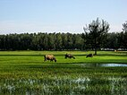
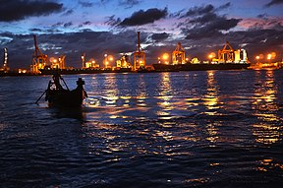
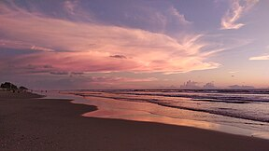


CHATTOGRAM
Chittagong Division officially Chattogram Division, is geographically the largest of the eight administrative divisions of Bangladesh. It covers the south-easternmost areas of the country, with a total area of 34,529.97 km² and a population at the 2022 census of 33,202,326.

Slide 6
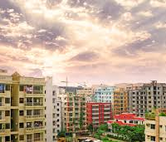
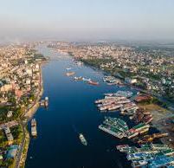
DHAKA
Dhaka Division is one of the eight administrative divisions of Bangladesh . It is located in the central region of Bangladesh.
Dhaka Division's GDP is $221.73 billion and GDP PPP is $497 billion.
The largest district in Dhaka Division by area is Tangail District and the smallest district is Narayanganj District .

Slide 7
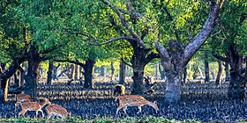
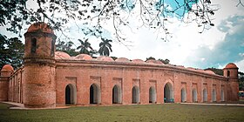
KHULNA
Dhaka Division is one of the eight administrative divisions of Bangladesh . It is located in the central region of Bangladesh.
Dhaka Division's GDP is $221.73 billion and GDP PPP is $497 billion.
The largest district in Dhaka Division by area is Tangail District and the smallest district is Narayanganj District .

Slide 8

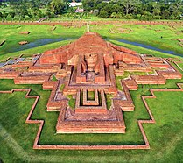
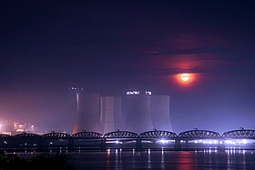
RAJSHAHI
Rajshahi Division (Bengali: রাজশাহী বিভাগ) is one of the eight first-level administrative divisions of Bangladesh. It has an area of 18,174.4 square kilometres (7,017.2 sq mi)^{[6]} and a population at the 2022 Census of 20,353,119.^{[7]} Rajshahi Division consists of 8 districts, 70 Upazilas (the next lower administrative tier) and 1,092 Unions (the lowest administrative tier).
The region has historically been dominated by various feudal Rajas, Maharajas and Zamindars.^{[8]} Formerly comprising 16 districts, a new division (Rangpur Division) was formed with the 8 northern districts of the old Rajshahi Division from early 2010.[

Slide 9
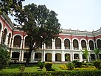
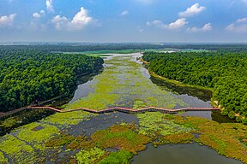
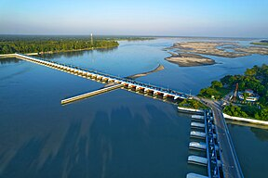
RANGPUR
Rangpur Division is a first-level administrative division of Bangladesh. It covers the northernmost part of the country with a population of about 18 million inhabitants within an area of 16,184.99 km2 (6,249.06 sq mi). Rangpur Division shares border with the Rajshahi and Mymensingh divisions. It is also bordered by the Indian states of West Bengal, Assam and Meghalaya and separated from Bhutan and Nepal by the Siliguri Corridor, and from China by the Indian state of Sikkim. Rangpur City is the administrative headquarter and the largest city. Rangpur Division includes the Teesta and Jamuna rivers.

Slide 10
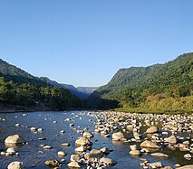

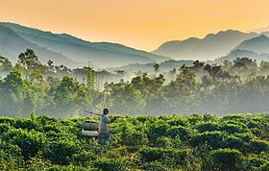
SYLHET
Sylhet Division is the northeastern division of Bangladesh. It is bordered by the Indian states of Meghalaya, Assam and Tripura to the north, east and south respectively, and by the divisions of Chittagong to the southwest and Dhaka and Mymensingh to the west.
Prior to the Partition in 1947, it included Karimganj subdivision (presently in Barak Valley, Assam, India). However, Karimganj (including the thanas of Badarpur, Patharkandi and Ratabari) was inexplicably severed from Sylhet by the Radcliffe Boundary Commission. According to Niharranjan Ray, it was partly due to a plea from a delegation led by Abdul Matlib Mazumdar.^{[16]}

